Slide 1
Global Superstore Analysis
Presented by Divas Rajan
29-sep-2023

Slide 2
CONTEXT
Global super store is getting losses, how to make it more profitable

Slide 3
CHALLENGES
Whether the shipping cost affect the profit
Is there any correlation between profit/loss and discount

Slide 4
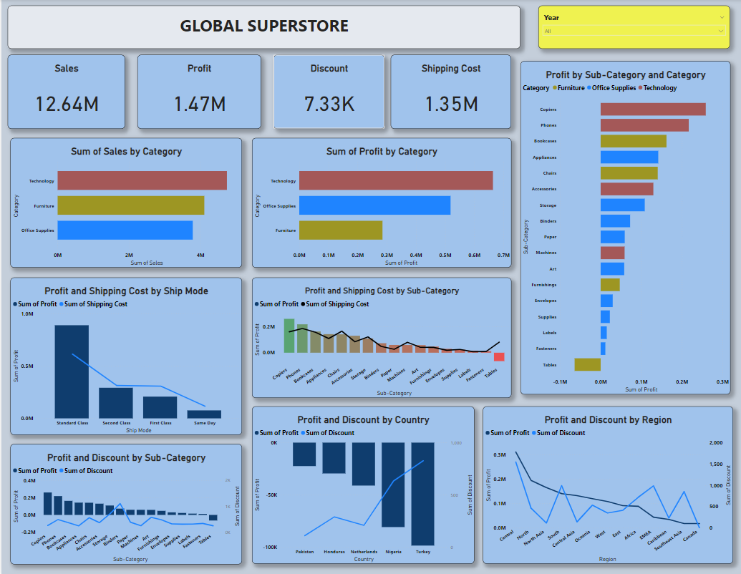

Slide 5
CONCLUSION
Shipping cost is more than profit except ‘standard’ shipping mode.
Discount rate is high in countries where company faces high loss.
Table subcategory under Furniture category face high loss, moreover shipping cost is also comparably high.

